Slide 1
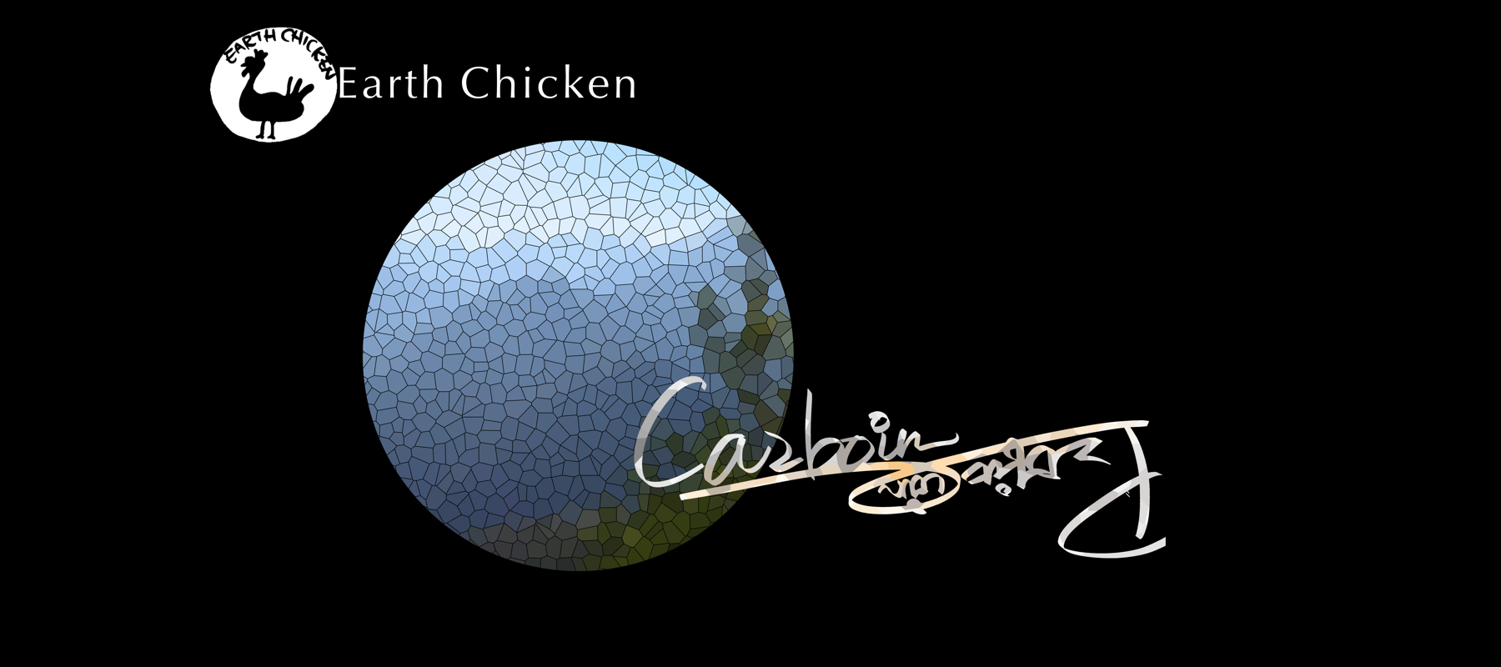

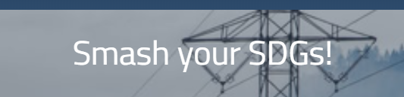
地球趣墾
#15 Life on Land
LEE CHIH-CHIN
SHYU CHASE JHIH-HUANG
JYH CHERNG JAN
CHEN WEI-CHIH
YU-HSIN HSUEH

Slide 2
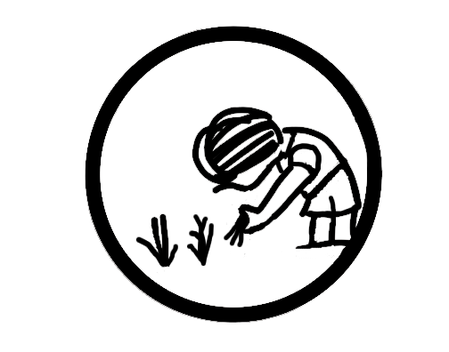
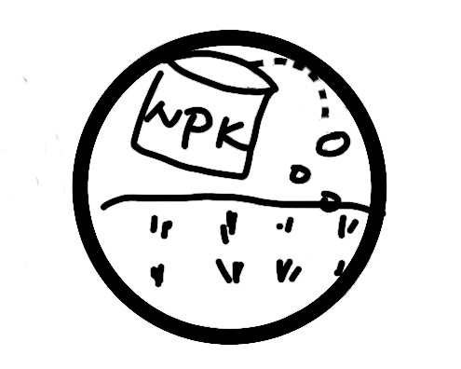
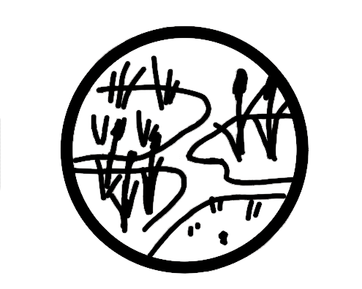

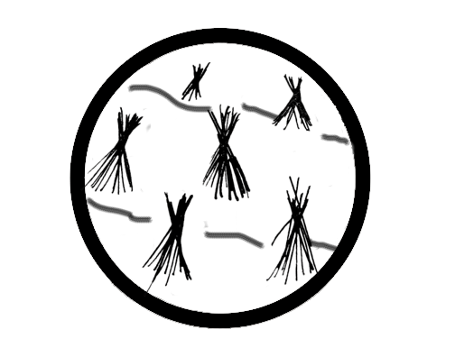
Carboin A NEW CURRENCY
Goal: Find out how to accumulate a large fortune through balancing your capital profit ($P) ) in harvesting timber and earn carbon coins ($C) with reducing carbon footprint.
目標: 找尋適合的氣候、土地條件，種植適合的物產，過程中累積碳足跡與金錢，尋找單位金錢最小碳足跡的勝利方程式。
Fertilize
Choose a type of plant
$C $P
Buy a land
Irrigate
Increase asset
Harvest

Slide 3
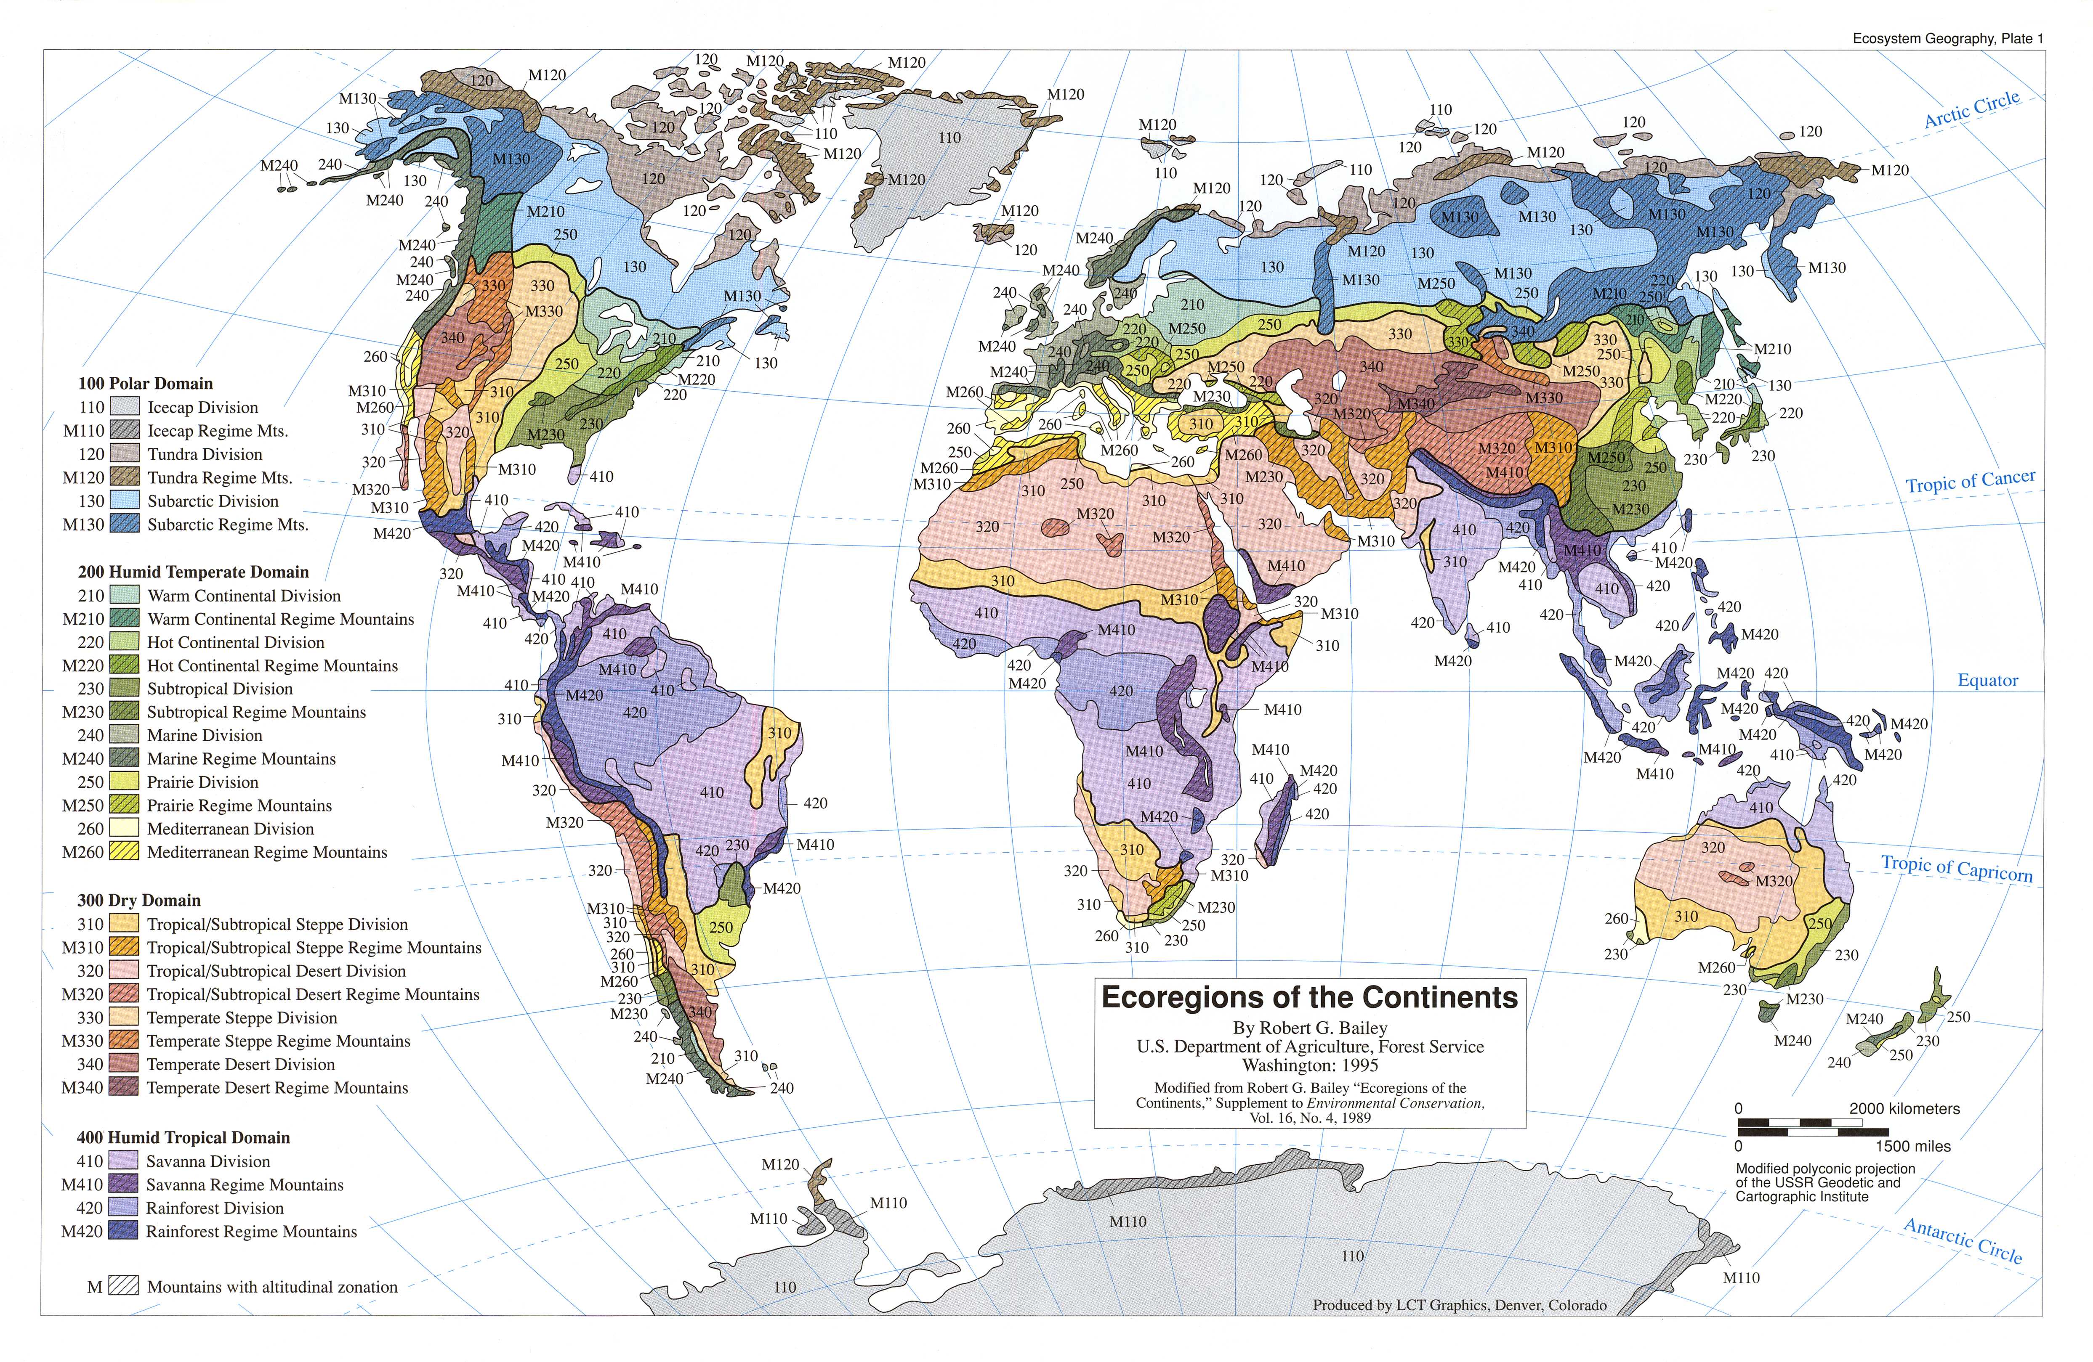
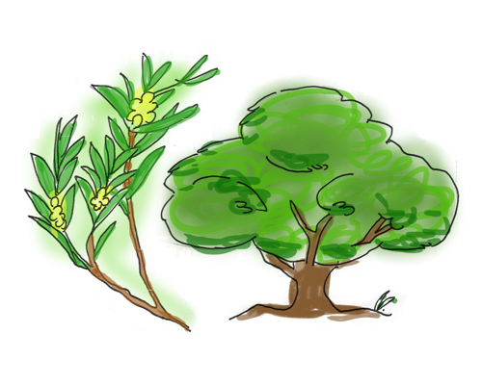
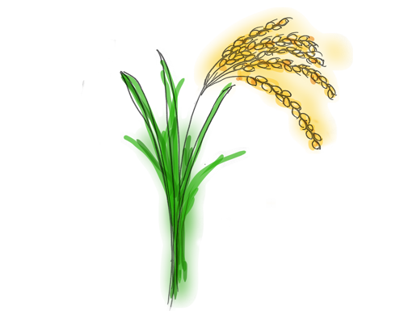
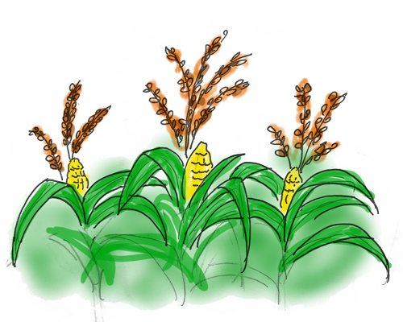
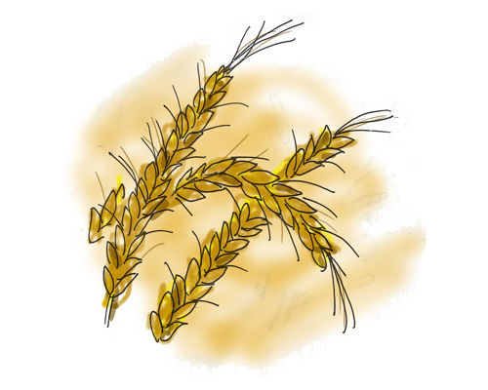
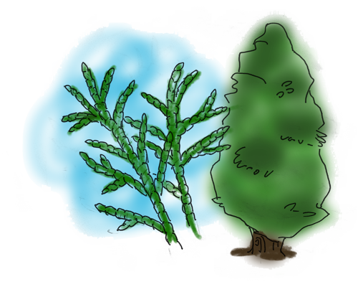
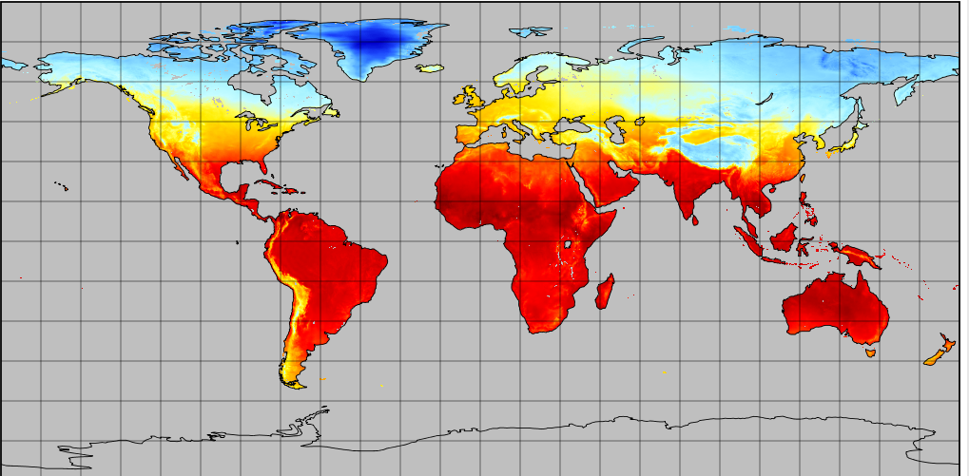
Pick a place to grow crops Caution: Land productivity is important!
Choose a type of plant:
Widely distributed crops or trees
Caution: which one makes more profit?
FAO (GAEZ)
Feedbacks
Ecoregion +ORCHIDEE
NASA GLDAS - Land Data Assimilation System
Air temperature and soil moisture are set as the input value that changes with time
Wait! Here comes a Drought!

Slide 4
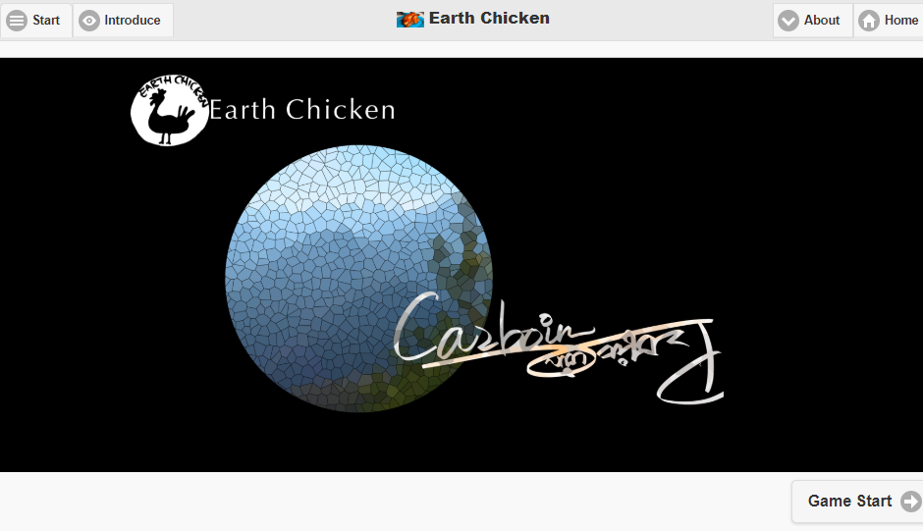
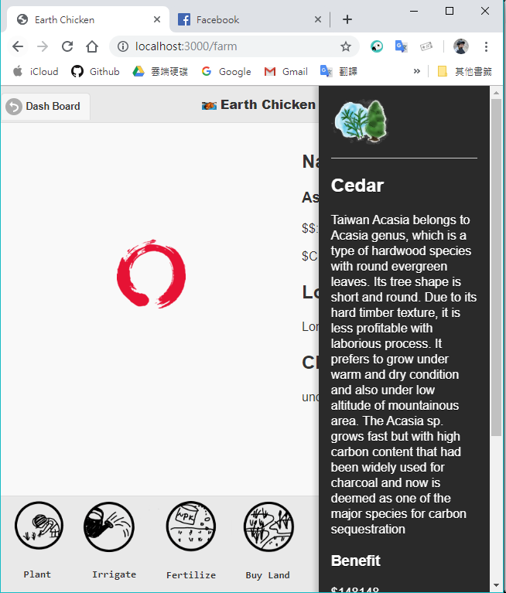
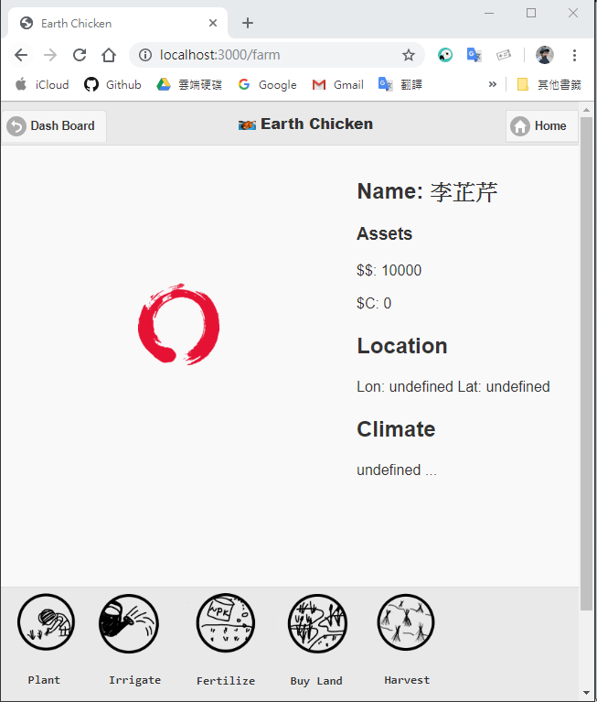
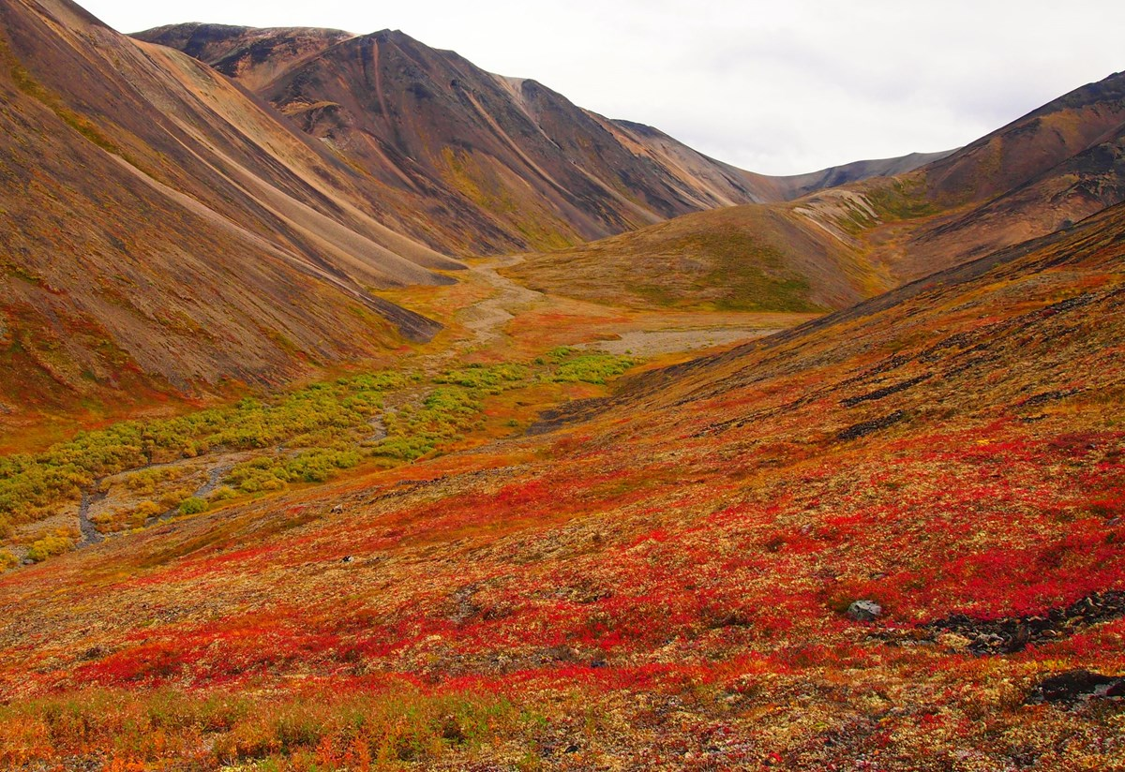
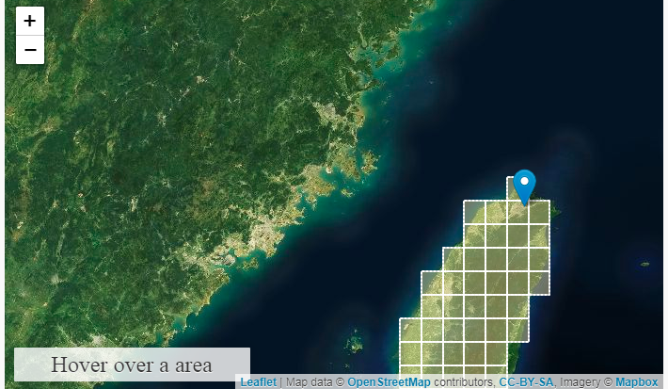
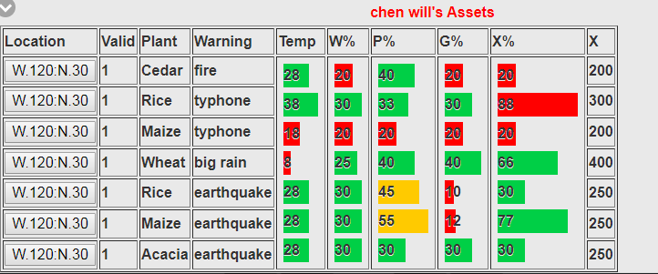
https://earthchicken.org
Log-in: start or retrieve your record
Time limit: 15 minutes to live through 15 years
Choose an action to proceed
Check your asset

Slide 5
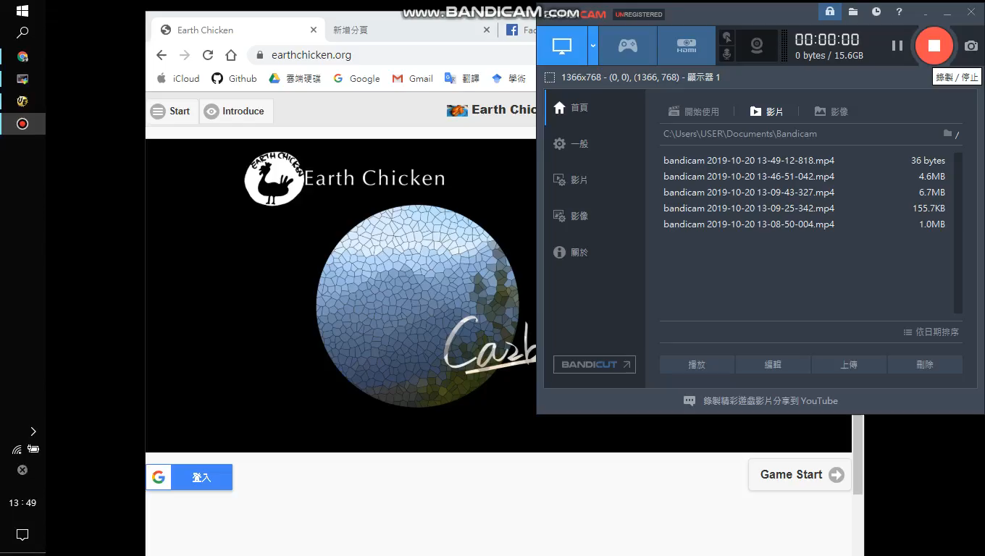
DEmo

Slide 6
Recap
透過這個模擬遊戲, 我們可以知道人類的活動會對自然產生影響。同時, 也進一步對植物的固碳作用有更深刻的理解, 希望玩家能透過遊戲去思考或許利益與地球永續發展的關係。
Through this simulated game, we would be able to understand more how human activity can do to the environment. Moreover, we gain more understanding on how much plants can store carbon. In the end, we hope the gamer will begin to think how profit plants have, and how can we balance the two currencies ($P and $C) to make Earth environment more sustainable.

Slide 7
References:
Vuichard, N., Messina, P., Luyssaert, S., Guenet, B., Zaehle, S., Ghattas, J., Bastrikov, V., and Peylin, P. 2018 Accounting for Carbon and Nitrogen interactions in the Global Terrestrial Ecosystem Model ORCHIDEE (trunk version, rev 4999): multi-scale evaluation of gross primary production, Geosci. Model Dev. Discuss., https://doi.org/10.5194/gmd-2018-261, in review.
Fischer, Günther & Nachtergaele, F. & Prieler, Sylvia & Teixeira, Edmar & Toth, Geza & Velthuizen, Harrij & Verelst, Luc & Wiberg, David. 2012 Global Agro‐Ecological Zones (GAEZ v3.0) - Model Documentation.

